Slide 1
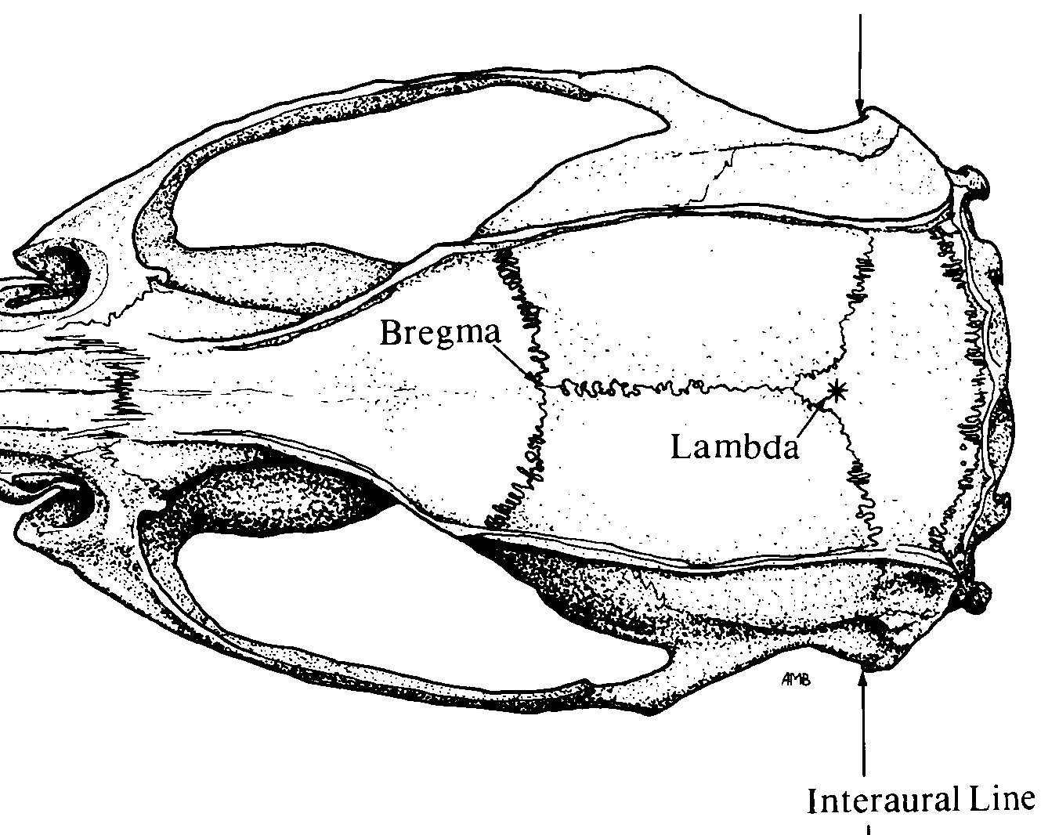
Optrode Pinnacle 3-Channel layout
Implant Map
Pin-out
1 GND | 2 EEG2 (EMG) | 3 EEG3 (optrode R-M1)
4 COMM | 5 EEG1 (L-M1) | 6 EEG3 (optrode R-M1)
White out
*
*
❺
❸ ❻
Bregma
Stereotaxic Coordinates
Location | Bregma | Midline
M1 | +1.5 (anterior) | ±2.0 (lateral)
EMG | Nuchal musc
Lambda
❹
❶
❷
Nuchal muscle
*
Anchor screw

